Slide 1
NLP

Slide 2
Introduction to NLP
Features and Unification

Slide 3
Need for Feature-based Grammars
Example (number agreement)
The dogs bites
Example (count/mass nouns)
many water
Example in French (number and person agreement w/subject)
Paul est parti, Michelle est partie, Ils sont partis, Elles sont parties
Example in French (number and person agreement w/direct object)
Je l’ai vu (I saw him), Je l’ai vue (I saw her)
Idea
S → NP VP
(but only if the person of the NP is equal to the person of the VP)

Slide 4
Parameterized Grammars
Parameterized rules, e.g.,
S → NP[person,number,”nominative” VP[person,number]
VP[person,number] → V[person,number] NP[person,number,”accusative”
NP[“first”,number,”nominative”] → DET[number]N[number]
Appropriate modifications are needed to the parser

Slide 5
Unification Grammars
Various unification grammar formalisms
LFG, HPSG, FUG
Handle agreement
e.g., number, gender, person
Unification
Two constituents can be combined only if their features can ‘unify’
Feature structures (FS or FD)
Nested structures that represent all features in an attribute-value matrix
Values are typed, so GENDER=PLURAL is not allowed
FSs can also be represented as graphs (DAG)
Feature paths (from root to a node in the graph)

Slide 6
Example in NLTK
import nltk;
from __future__ import print_function
from nltk.featstruct import FeatStruct
from nltk.sem.logic import Variable, VariableExpression, Expression
fs1 = FeatStruct(number='singular', person=3)
print (fs1)
[ number = 'singular' ]
[ person = 3 ]
fs2 = FeatStruct(type='NP', agr=fs1)
print (fs2)
[ agr = [ number = 'singular' ] ]
[ [ person = 3 ] ]
[ ]
[ type = 'NP' ]
http://www.nltk.org/howto/featstruct.html

Slide 7
Feature Unification
Graph-matching
Recursive definition
Two FSs unify if they can be merged into a consistent FS
Leaf nodes unify if:
They are the same
One can “subsume” the other
Special case: One or both are blank

Slide 8
Feature Unification
U
CAT NP
PERSON 3
NUMBER SINGULAR
CAT NP
NUMBER SINGULAR
PERSON 3
CAT NP
NUMBER SINGULAR
PERSON 3

Slide 9
Feature Unification
U
CAT NP
PERSON 3
NUMBER SINGULAR
CAT NP
PERSON 1
PERSON 3
FAILURE

Slide 10
Example in NLTK
fs2 = FeatStruct(type='NP', agr=fs1)
print (fs2)
[ agr = [ number = 'singular' ] ]
[ [ person = 3 ] ]
[ ]
[ type = 'NP' ]
fs3 = FeatStruct(agr=FeatStruct(number=Variable('?n')), subj=FeatStruct(number=Variable('?n')))
print(fs3)
[ agr = [ number = ?n ] ]
[ ]
[ subj = [ number = ?n ] ]
print(fs2.unify(fs3))
[ agr = [ number = 'singular' ] ]
[ [ person = 3 ] ]
[ ]
[ subj = [ number = 'singular' ] ]
[ ]
[ type = 'NP' ]
http://www.nltk.org/howto/featstruct.html

Slide 11
Agreement with Features
S → NP VP
{NP PERSON} = {VP PERSON}
S → Aux NP VP
{Aux PERSON} = {NP PERSON}
Verb → bites
{Verb PERSON} = 3
Verb → bite
{Verb PERSON} = 1

Slide 12
Types in Semantics
e – entities, t – facts
<e,t> : unary predicates – maps entities to facts
<e,<e,t>> : binary predicates
<<e,t>,t> : type-raised entities
Examples:
“Jorge”, “he”, A123: e
“Janice likes cats”: t
“likes”: <e,<e,t>>
“likes cats”: <e,t>
“every person”: <<e,t>,t>

Slide 13
Type Coercion
Programming languages
How is it done in your favorite programming language?
Examples in natural language
I had a coffee this morning (-> one cup of coffee)
I tried two wines last night (-> two types of wine)
I had fish for dinner (-> some fish, not “a fish”)

Slide 14
Subtypes and Selectional Restrictions
Type hierarchy
object > edible object > fruit > banana
noun > count noun
noun > mass noun
Selectional restrictions
Some verbs can only take arguments of certain types
Example: eat + “edible object”, believe + “idea“
Selectional restrictions and type coercion (metonymy)
I have read this title (“title” -> “book”)
I like Shakespeare (“Shakespeare” -> “works by Shakespeare”)

Slide 15
Subcategorization with Features
VP → Verb
{VP SUBCAT} = {Verb SUBCAT} {VP SUBCAT} = INTRANS
VP → Verb NP
{VP SUBCAT} = {Verb SUBCAT} {VP SUBCAT} = TRANS
VP → Verb NP NP
{VP SUBCAT} = {Verb SUBCAT} {VP SUBCAT} = DITRANS

Slide 16
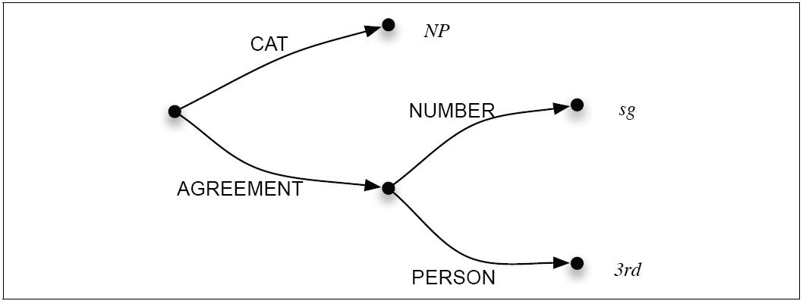
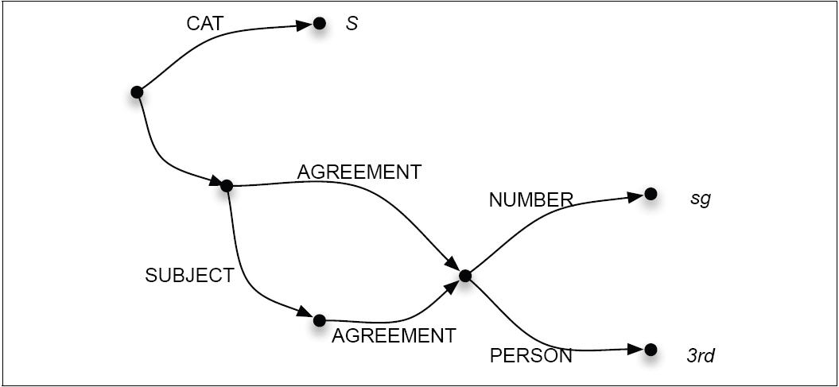
Representing FSs as DAGs
FS = feature structure
DAG = directed acyclic graph (not a tree and not an arbitrary graph)
[Example from Jurafsky and Martin]

Slide 17
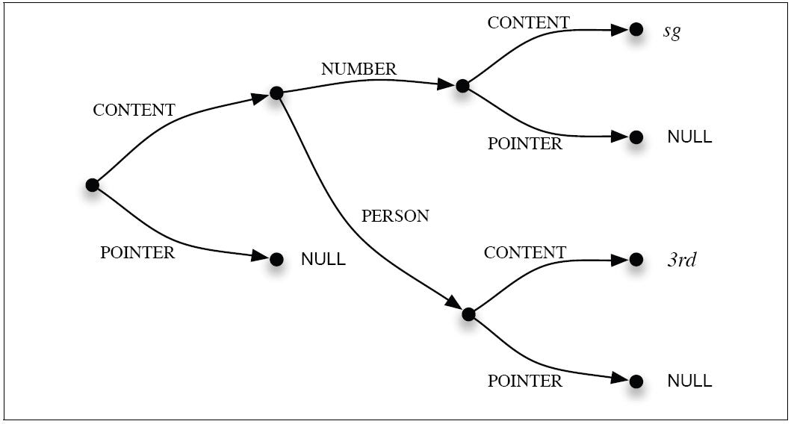
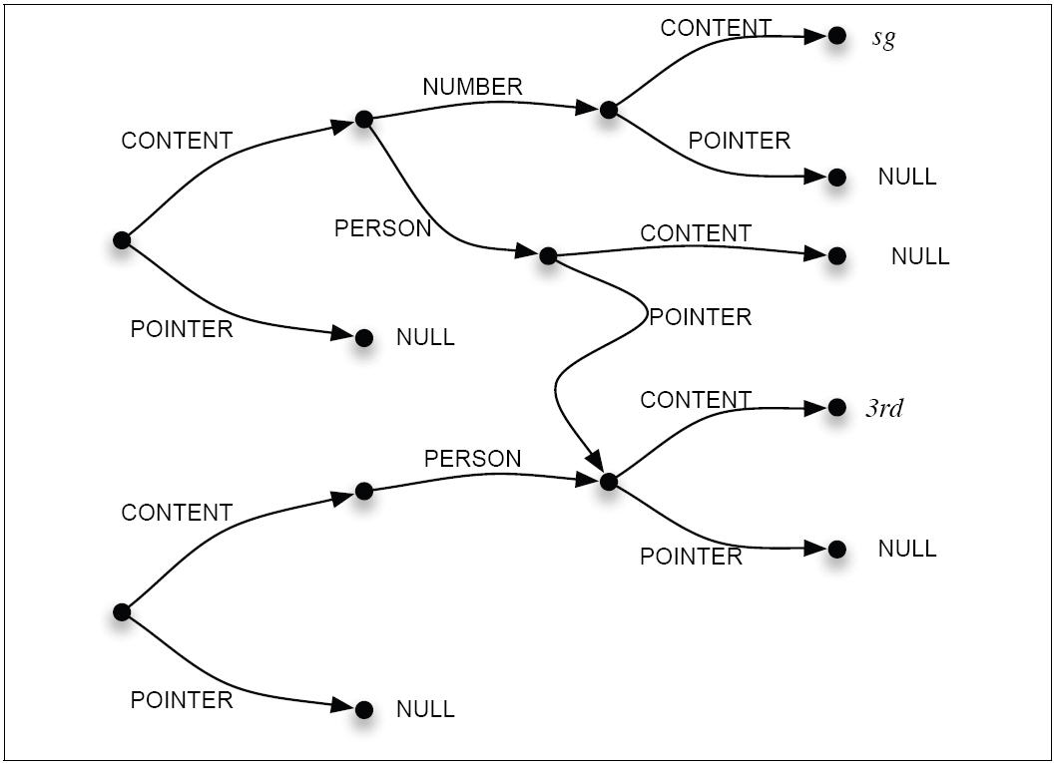
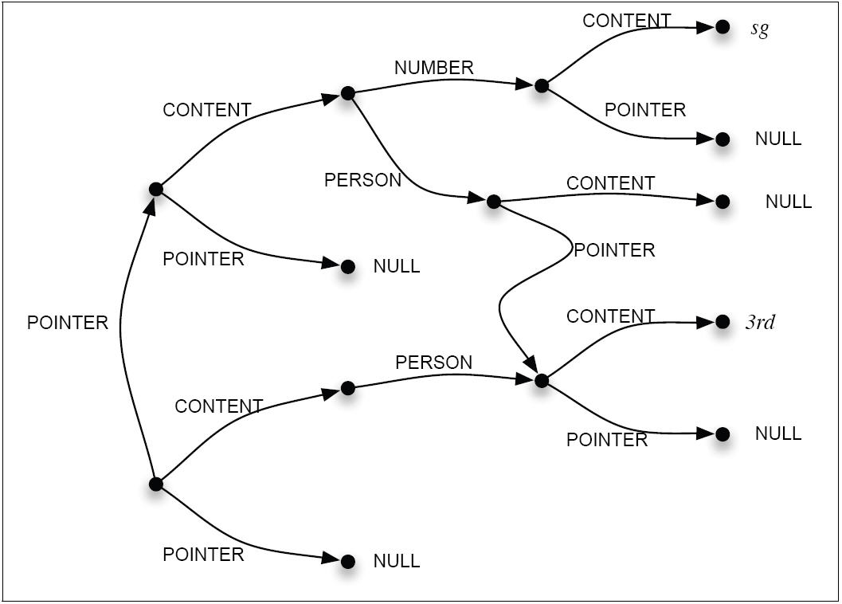
FS Unification
[Example from Jurafsky and Martin]

Slide 18
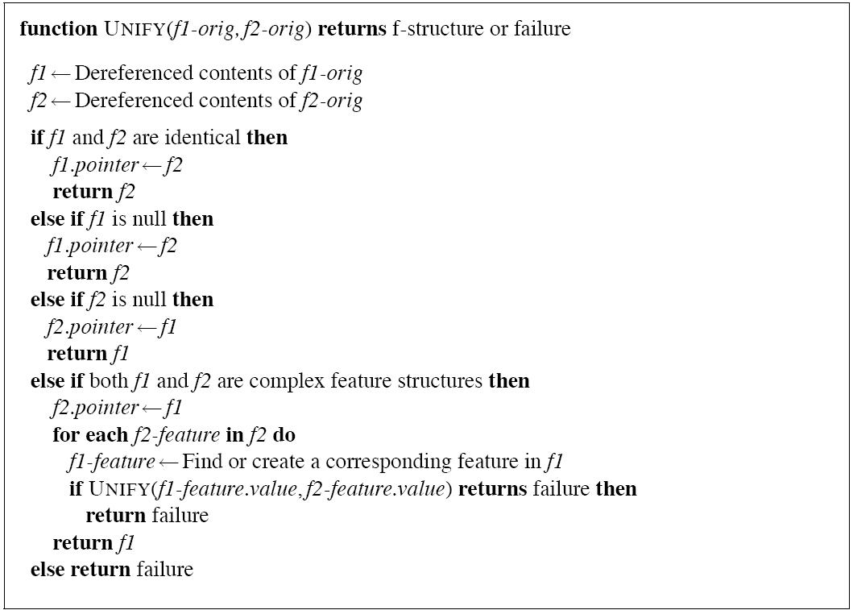
Unification Procedure
[Example from Jurafsky and Martin]

Slide 19
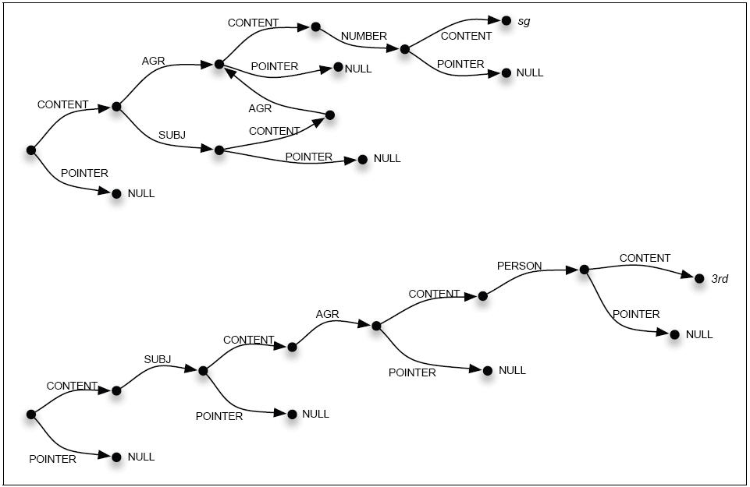
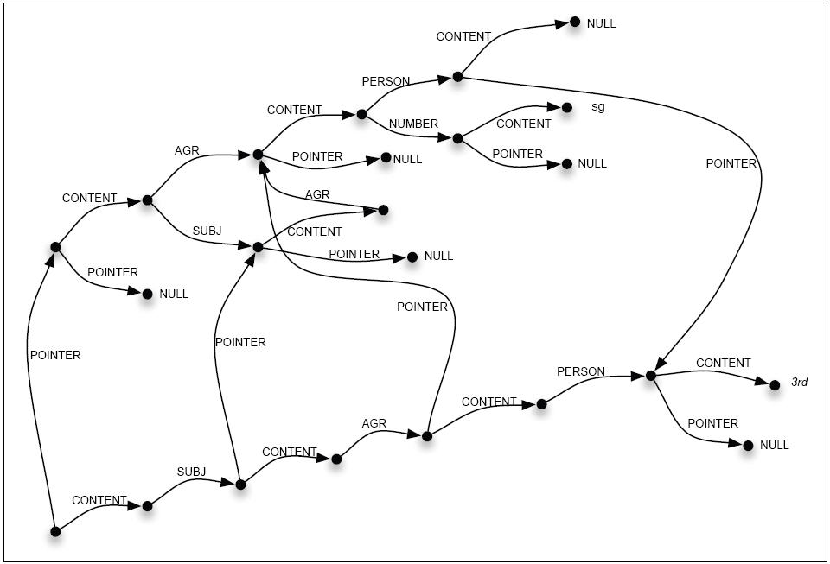
FS Unification
[Example from Jurafsky and Martin]

Slide 20
Subsumption
Unification of a more general concept with a more specific concept
“undefined” is the most general concept
“fail” is the least general concept

Slide 21
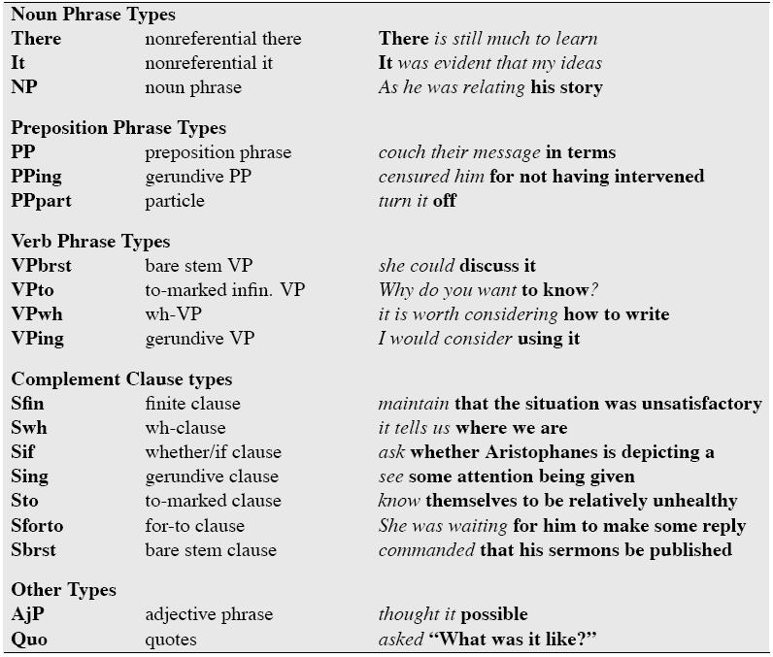
Subcategorization
[Example from Jurafsky and Martin]

Slide 22
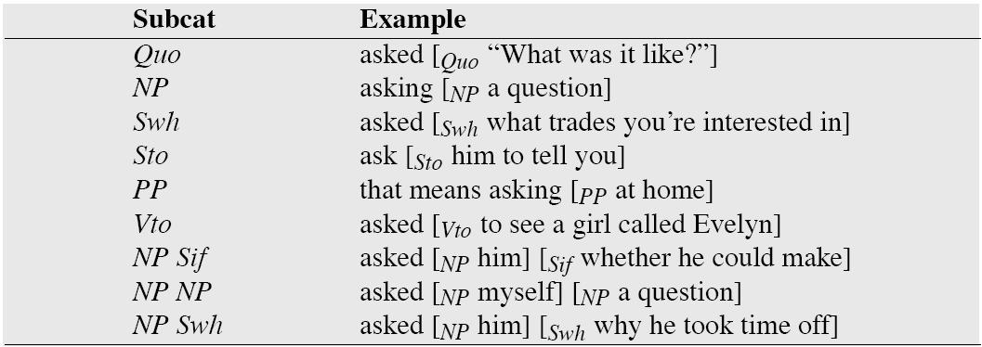
Subcategorization
[Example from Jurafsky and Martin]

Slide 23
Notes
FSs can have a special, “head” feature
If all features have a finite domain, attribute-value grammars can be converted into a CFG
The power-of-2 language doesn’t have the “constant growth property”.
It is a CSL and cannot be recognized by a CFG.
It can, however, be recognized by a mildly-context-sensitive grammar.

Slide 24
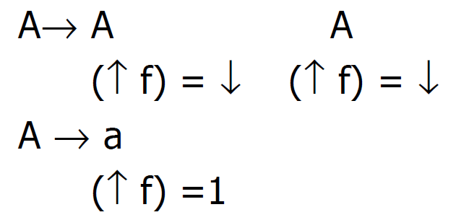
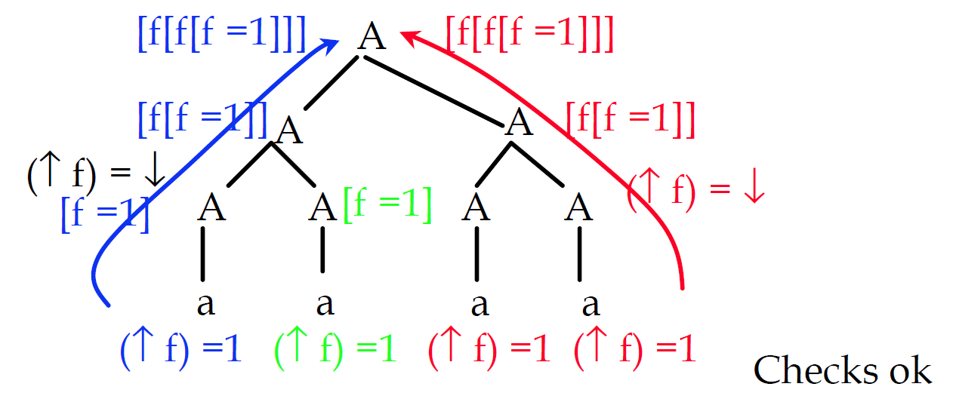
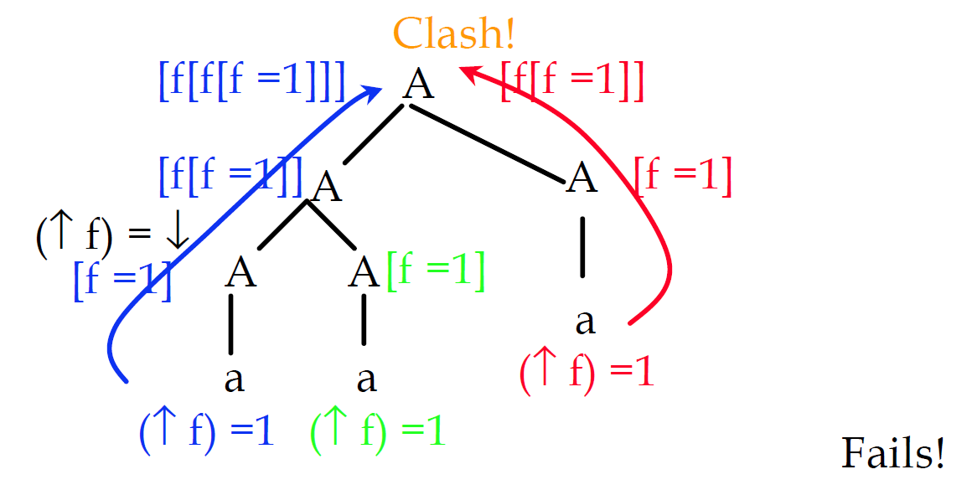
“Power-of-2 Language”
Can be generated by an LFG (Bresnan 82)
[Example from Bob Berwick]

Slide 25
Summary
Feature structures define constraints
Subsumption
Nested features structures
Cycles are allowed (DAG)
Unification
Types
Type subsumption

Slide 26
NLP

